Slide 1
Parkinson’s Disease Detection Using Voice Measurements
Machine Learning Project Report
By- Surabhi Pandey

Slide 2
Introduction
• Parkinson’s Disease (PD) is a degenerative neurological disorder.
• Affects speech: dysarthria, hypophonia, monotone.
• Traditional diagnosis involves clinical observation.
• Voice analysis via ML offers a non-invasive screening method.

Slide 3
Dataset Details
• Dataset contains 195 voice recordings from 31 individuals (23 with PD).
• Each row = one voice recording.
• 24 biomedical voice features + status (0 = healthy, 1 = PD).
• Source: UCI ML Repository, Little et al., 2007.

Slide 4
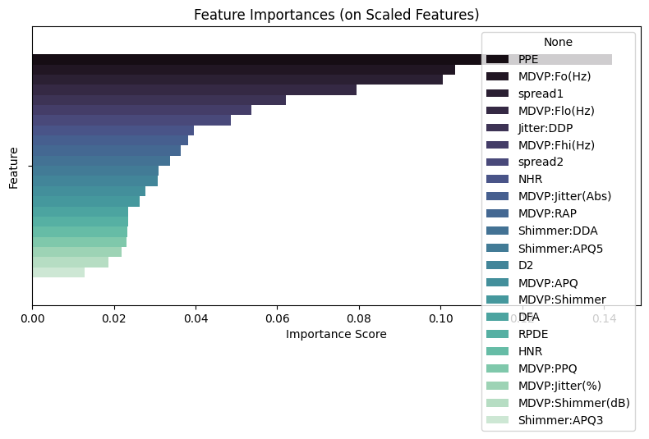
Features & Target Variable
• Features: PPE, MDVP:Fo(Hz), spread1, MDVP:Flo(Hz), etc.
• Target: status (binary classification).
• Top features by importance (Random Forest):
- PPE: 0.14
- MDVP:Fo(Hz): 0.10
- spread1: 0.10
- MDVP:Flo(Hz): 0.08

Slide 5
Model and Training
• Algorithm used: Random Forest Classifier
• Train-test split: 80-20 ratio
• Hyperparameters: default
• Importance-based feature selection applied

Slide 6
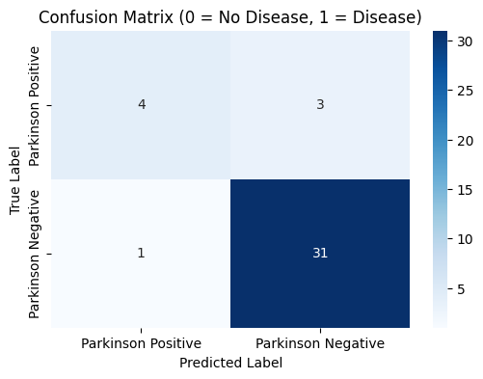
Model Performance
• Accuracy: 89.74%
• Precision: 91.18%
• Recall: 96.88%
• F1 Score: 93.94%
• Support:
- Class 0 (healthy): 7 samples
- Class 1 (PD): 32 samples

Slide 7
Conclusion
• ML can effectively classify PD using voice features.
• Random Forest achieved ~90% accuracy.
• Can aid in early screening without clinic visit.
• Future: expand dataset, test other models, deploy as app.

Slide 8
Contact & GitHub
GitHub Repository:https://github.com/surabhipandey18/Parkinson-Disorder
Email: pandeysurabhi59@gmail.com
LinkedIn: https://www.linkedin.com/in/surabhi-pandey18
Institute: Indian Institute of Technology Guwahati (IITG)

